Slide 1
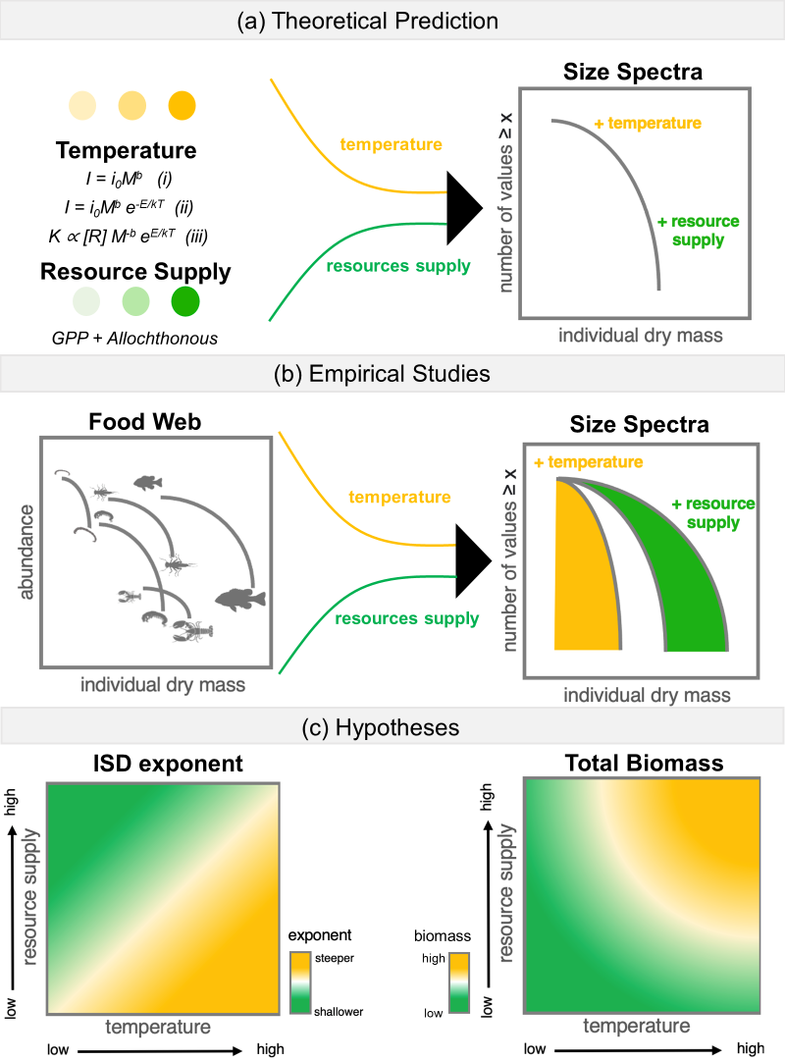

Slide 2

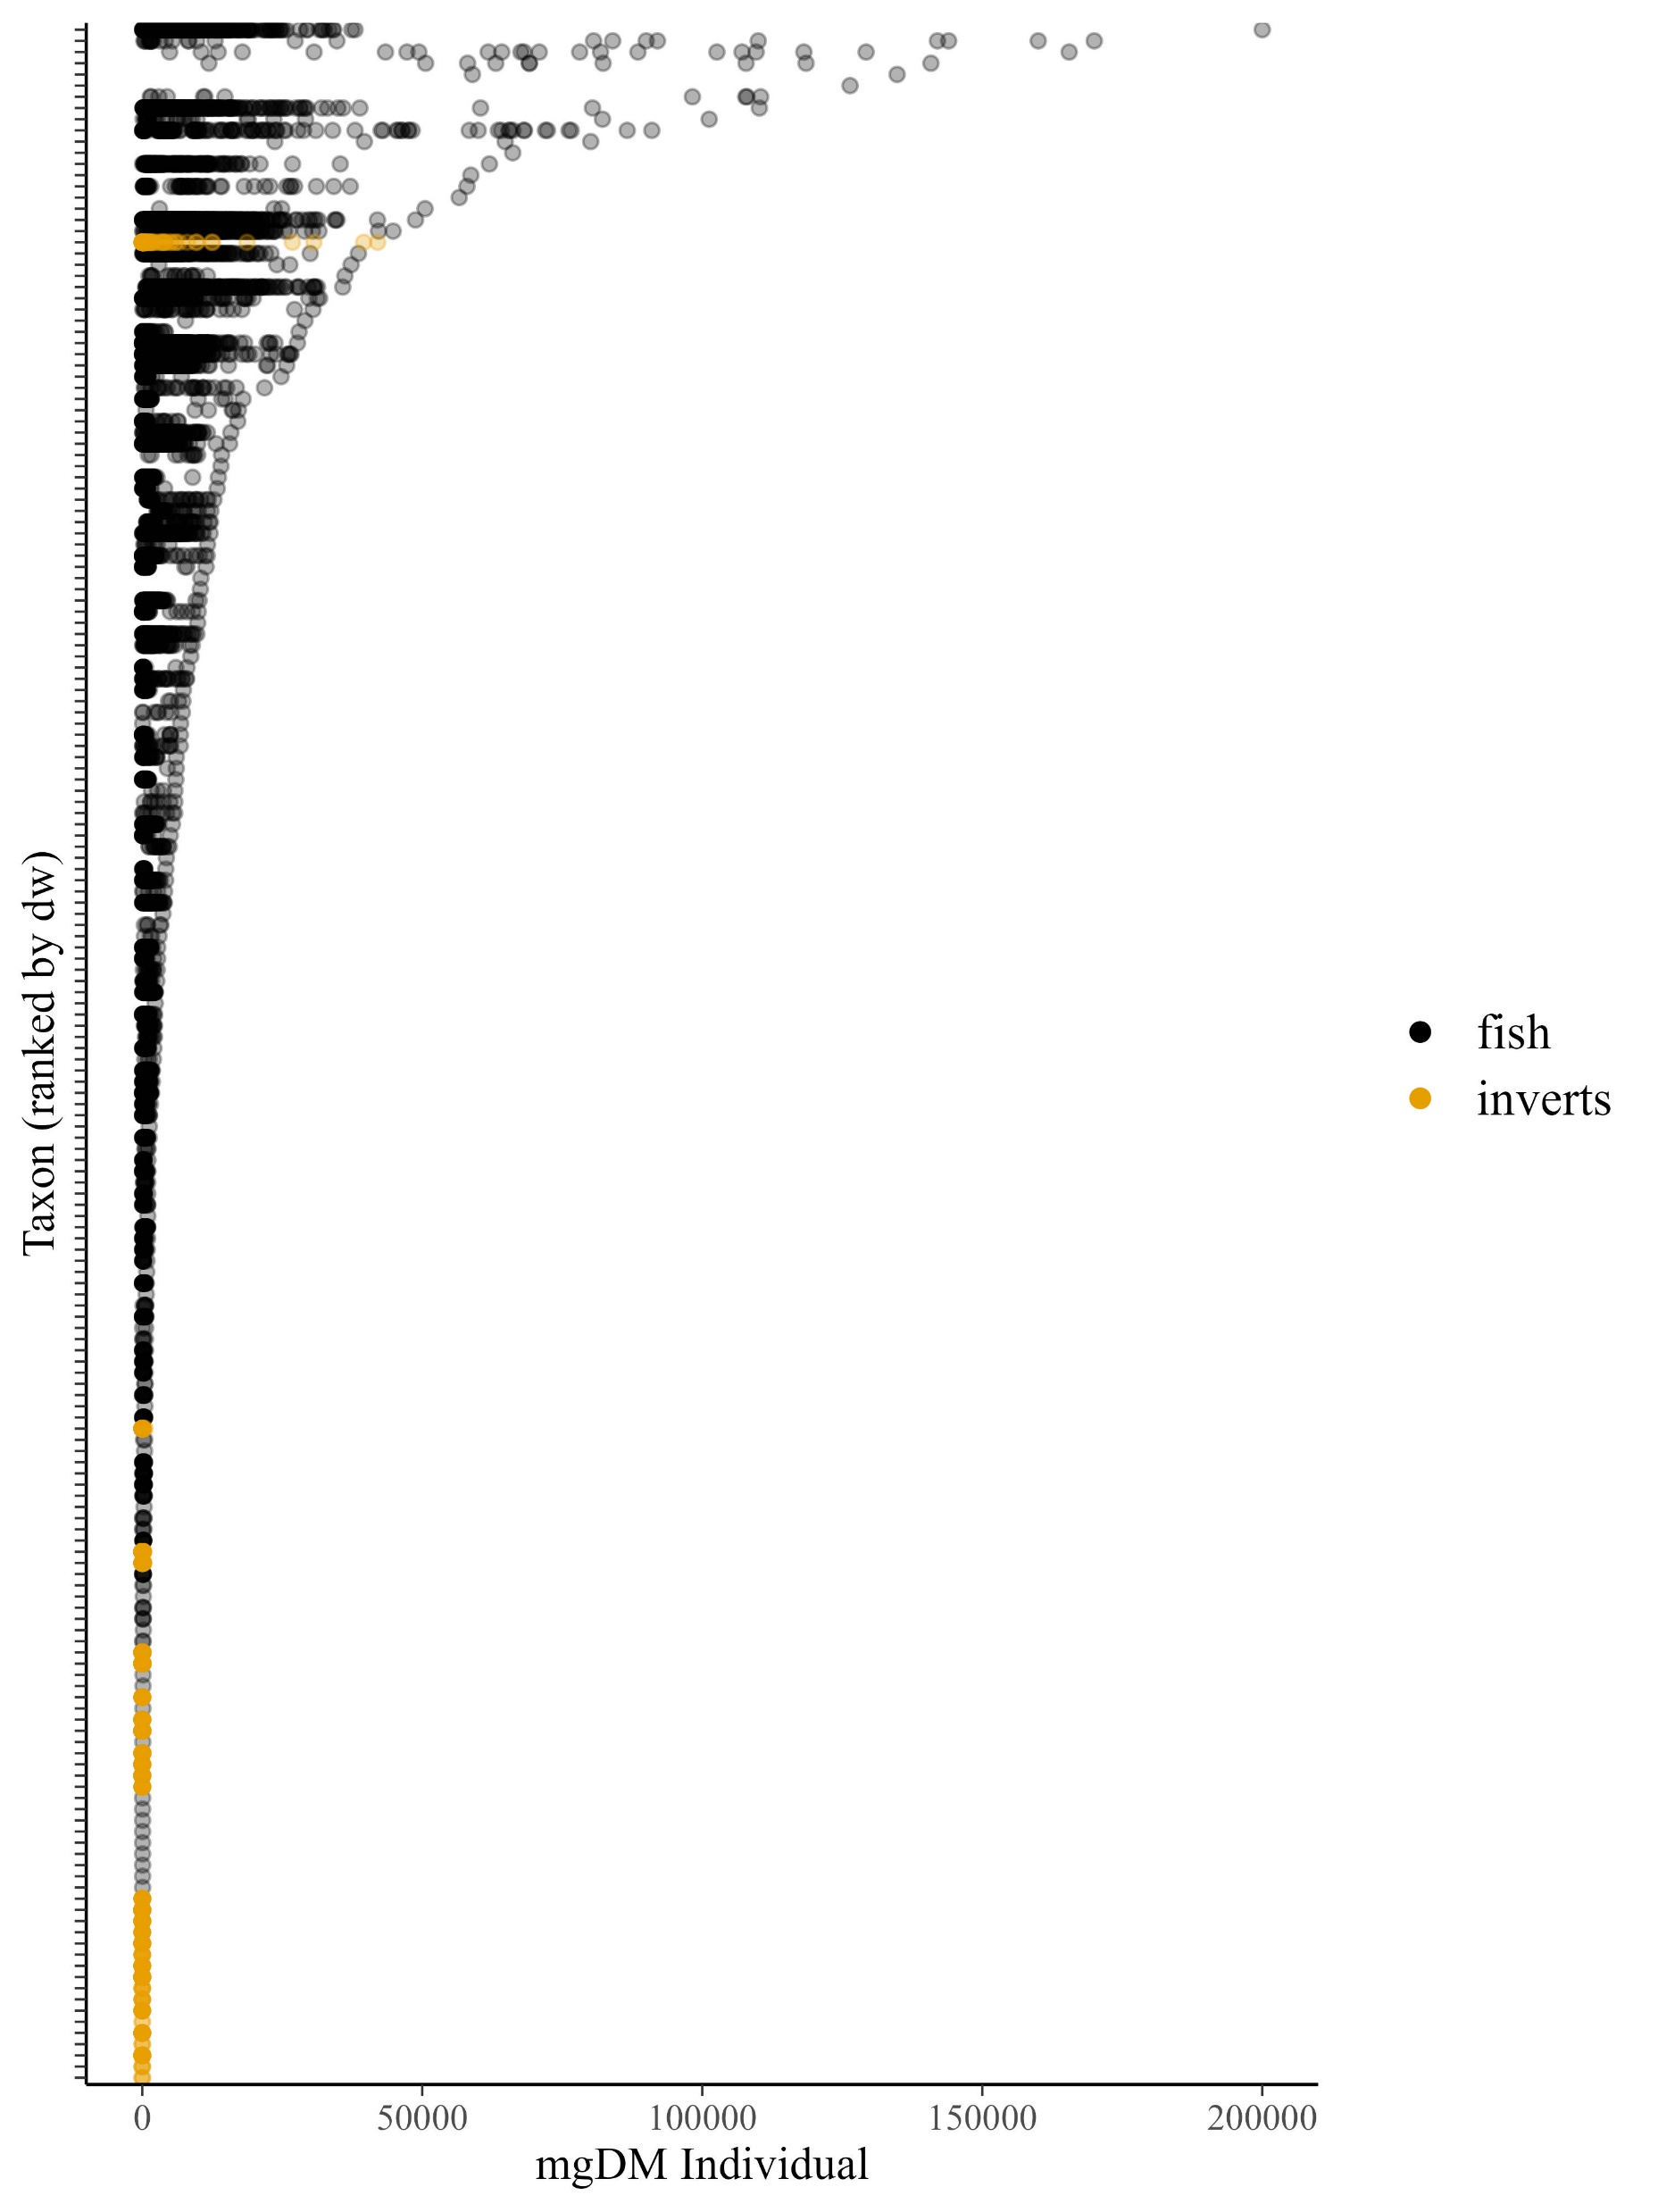







Slide 3
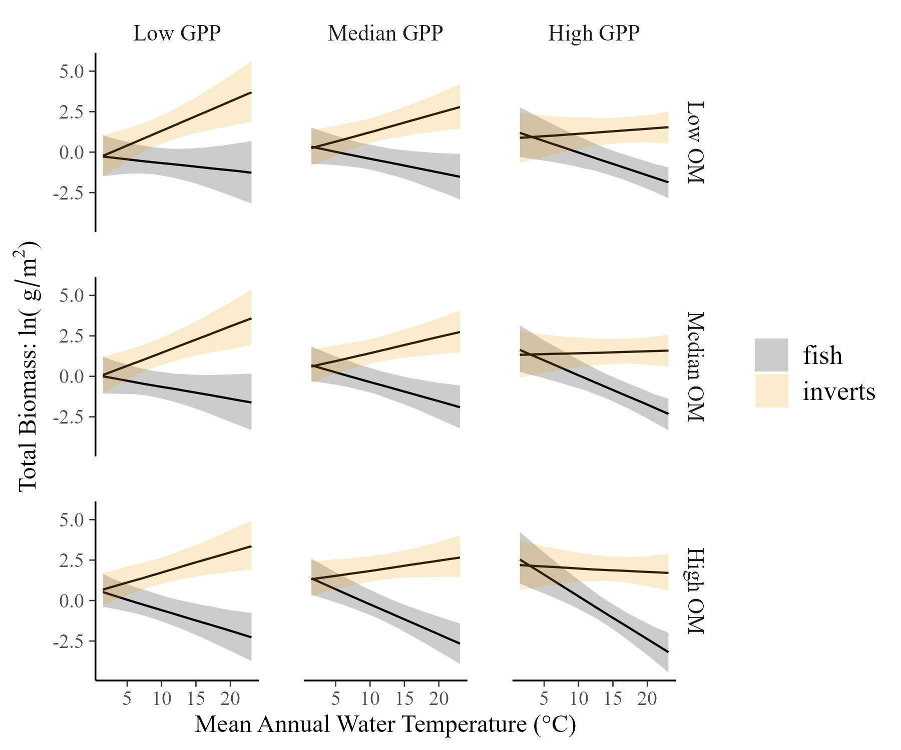
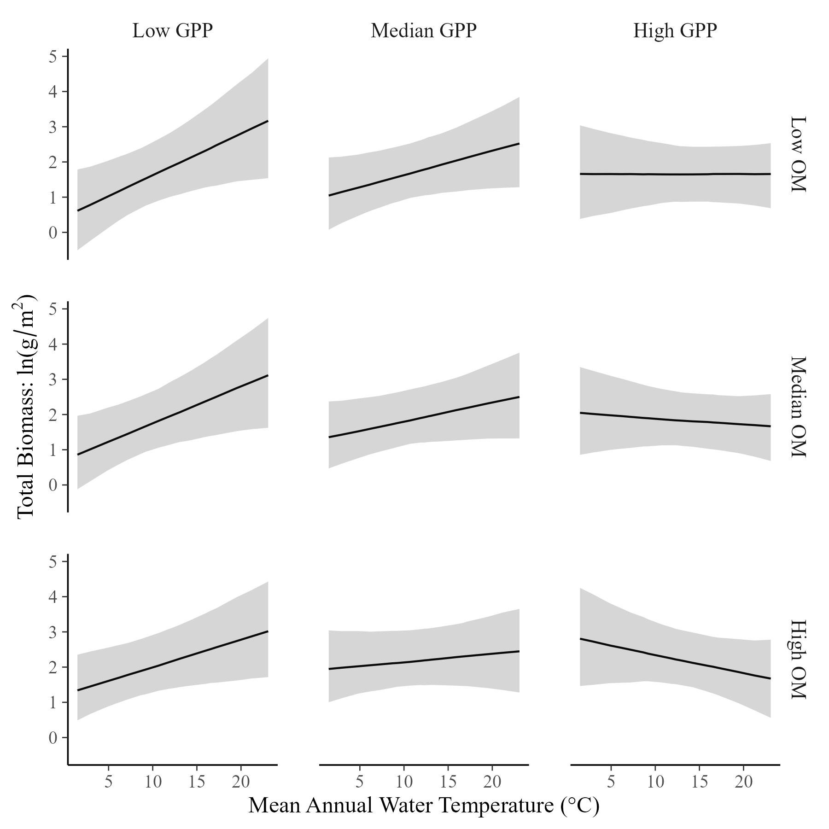
Total Community Biomass varies with temperature and resources…
…and it appears to be a compromise between fish and invertebrates

Slide 4
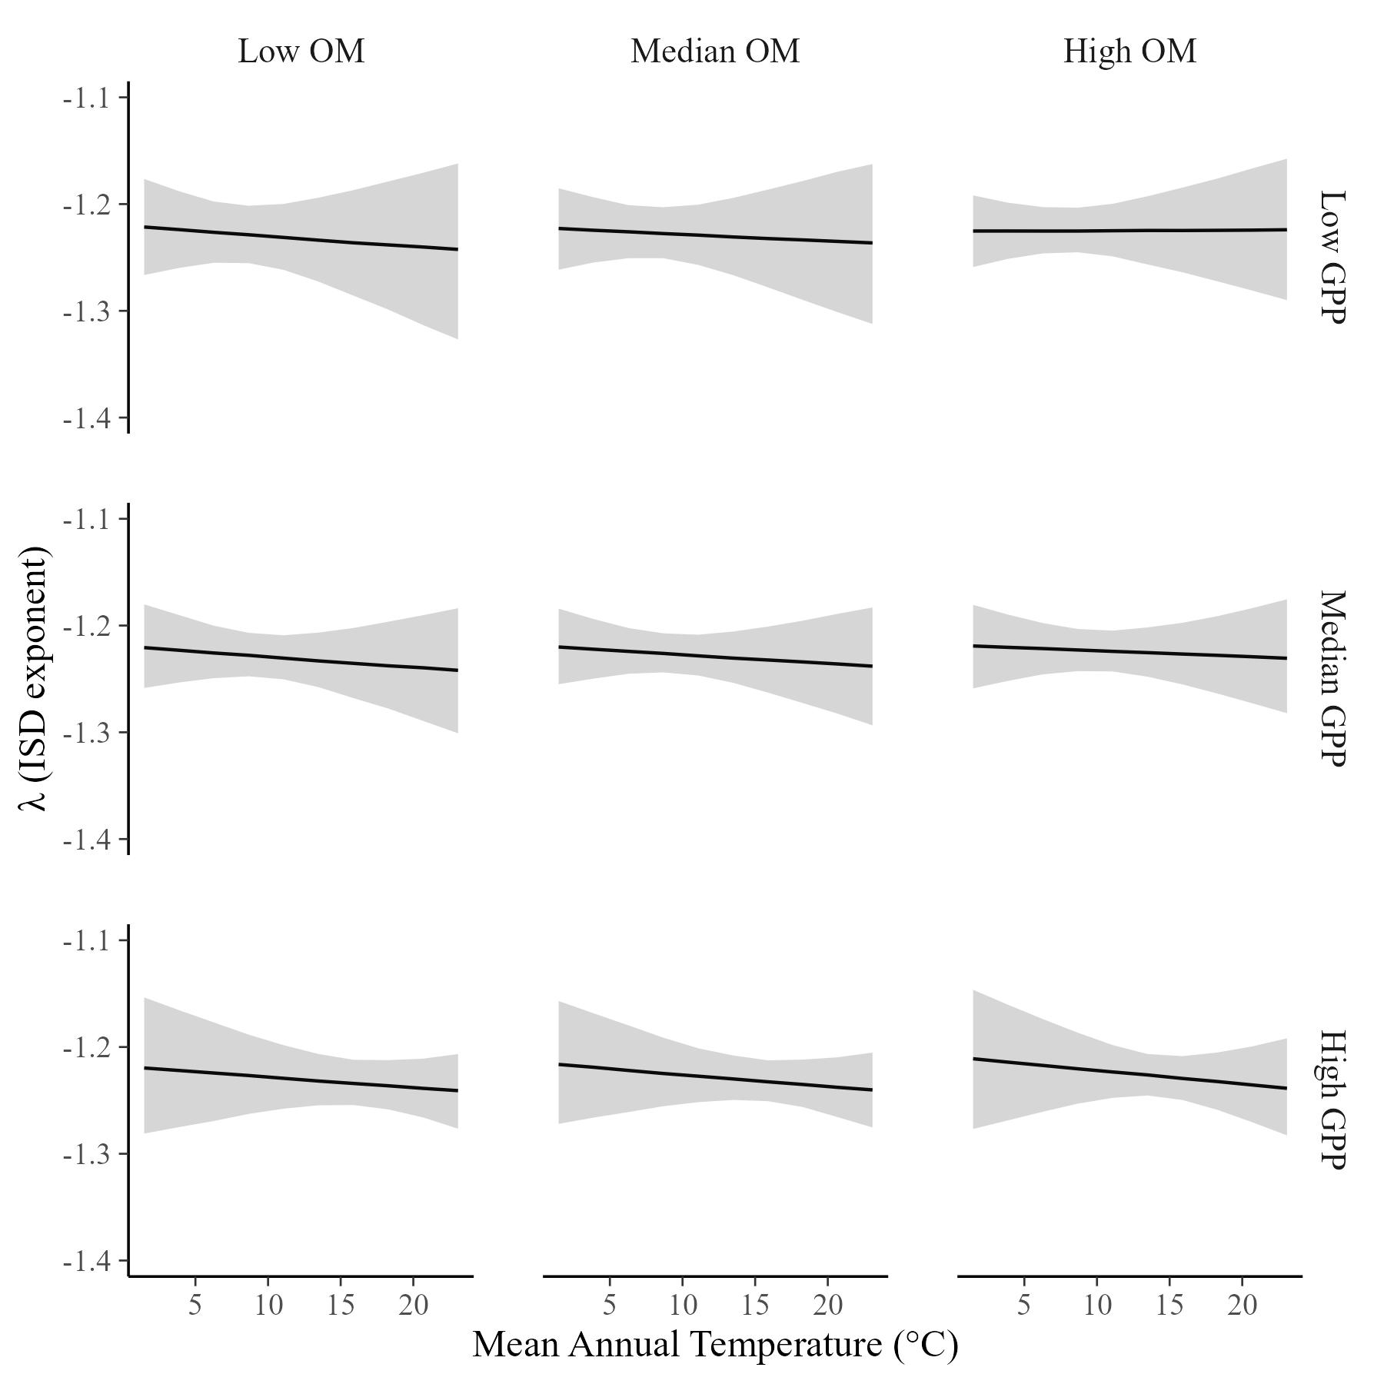
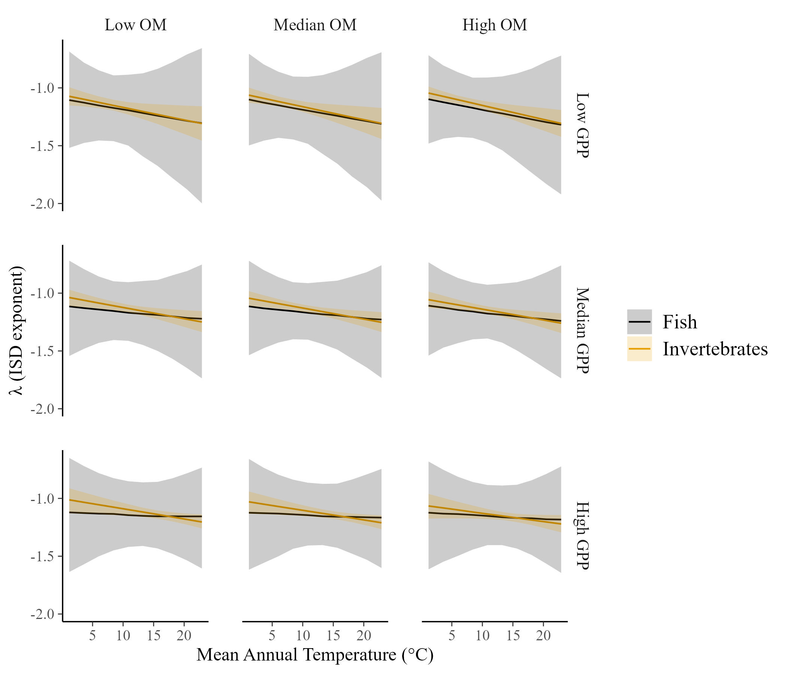
The ISD is constant across temperature and resource supply
…With similar slopes for fish and macroinvertebrates

Slide 5
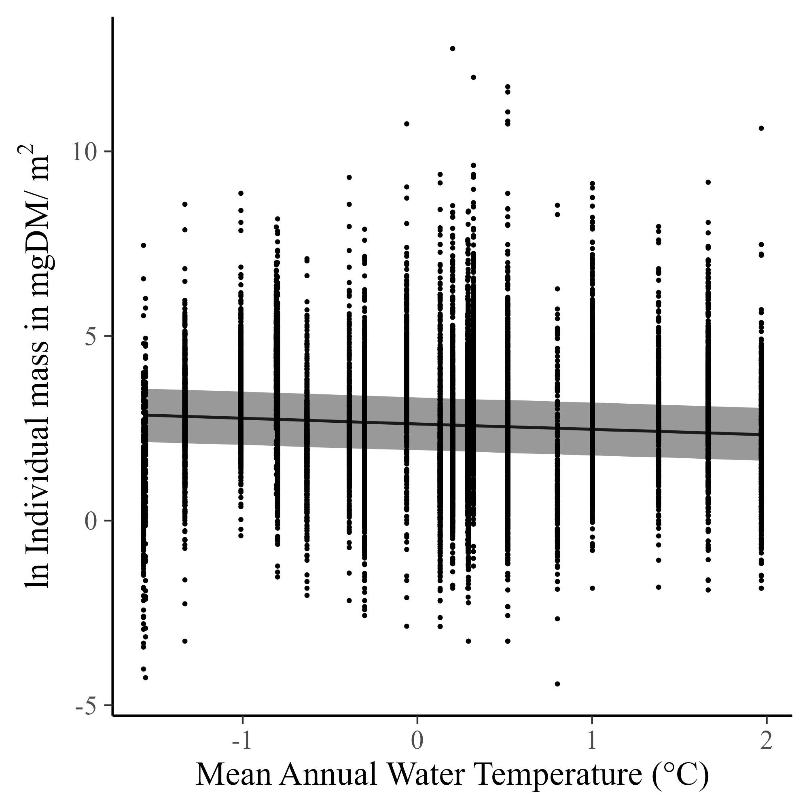
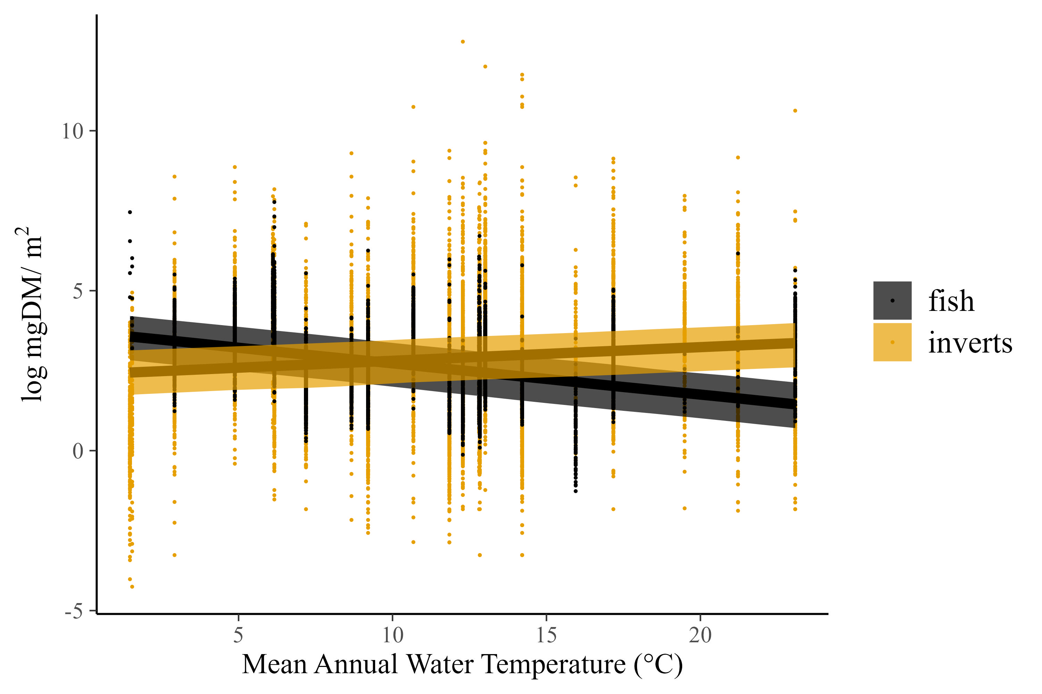
Mean individual sizes decline across temperature….but just barely, from ~13mgDM at the coldest streams to 10mgDM at the warmest (after back-transforming)
Fish and inverts show opposite trends in mean individual mass, with fish declining and inverts increasing.

Slide 6
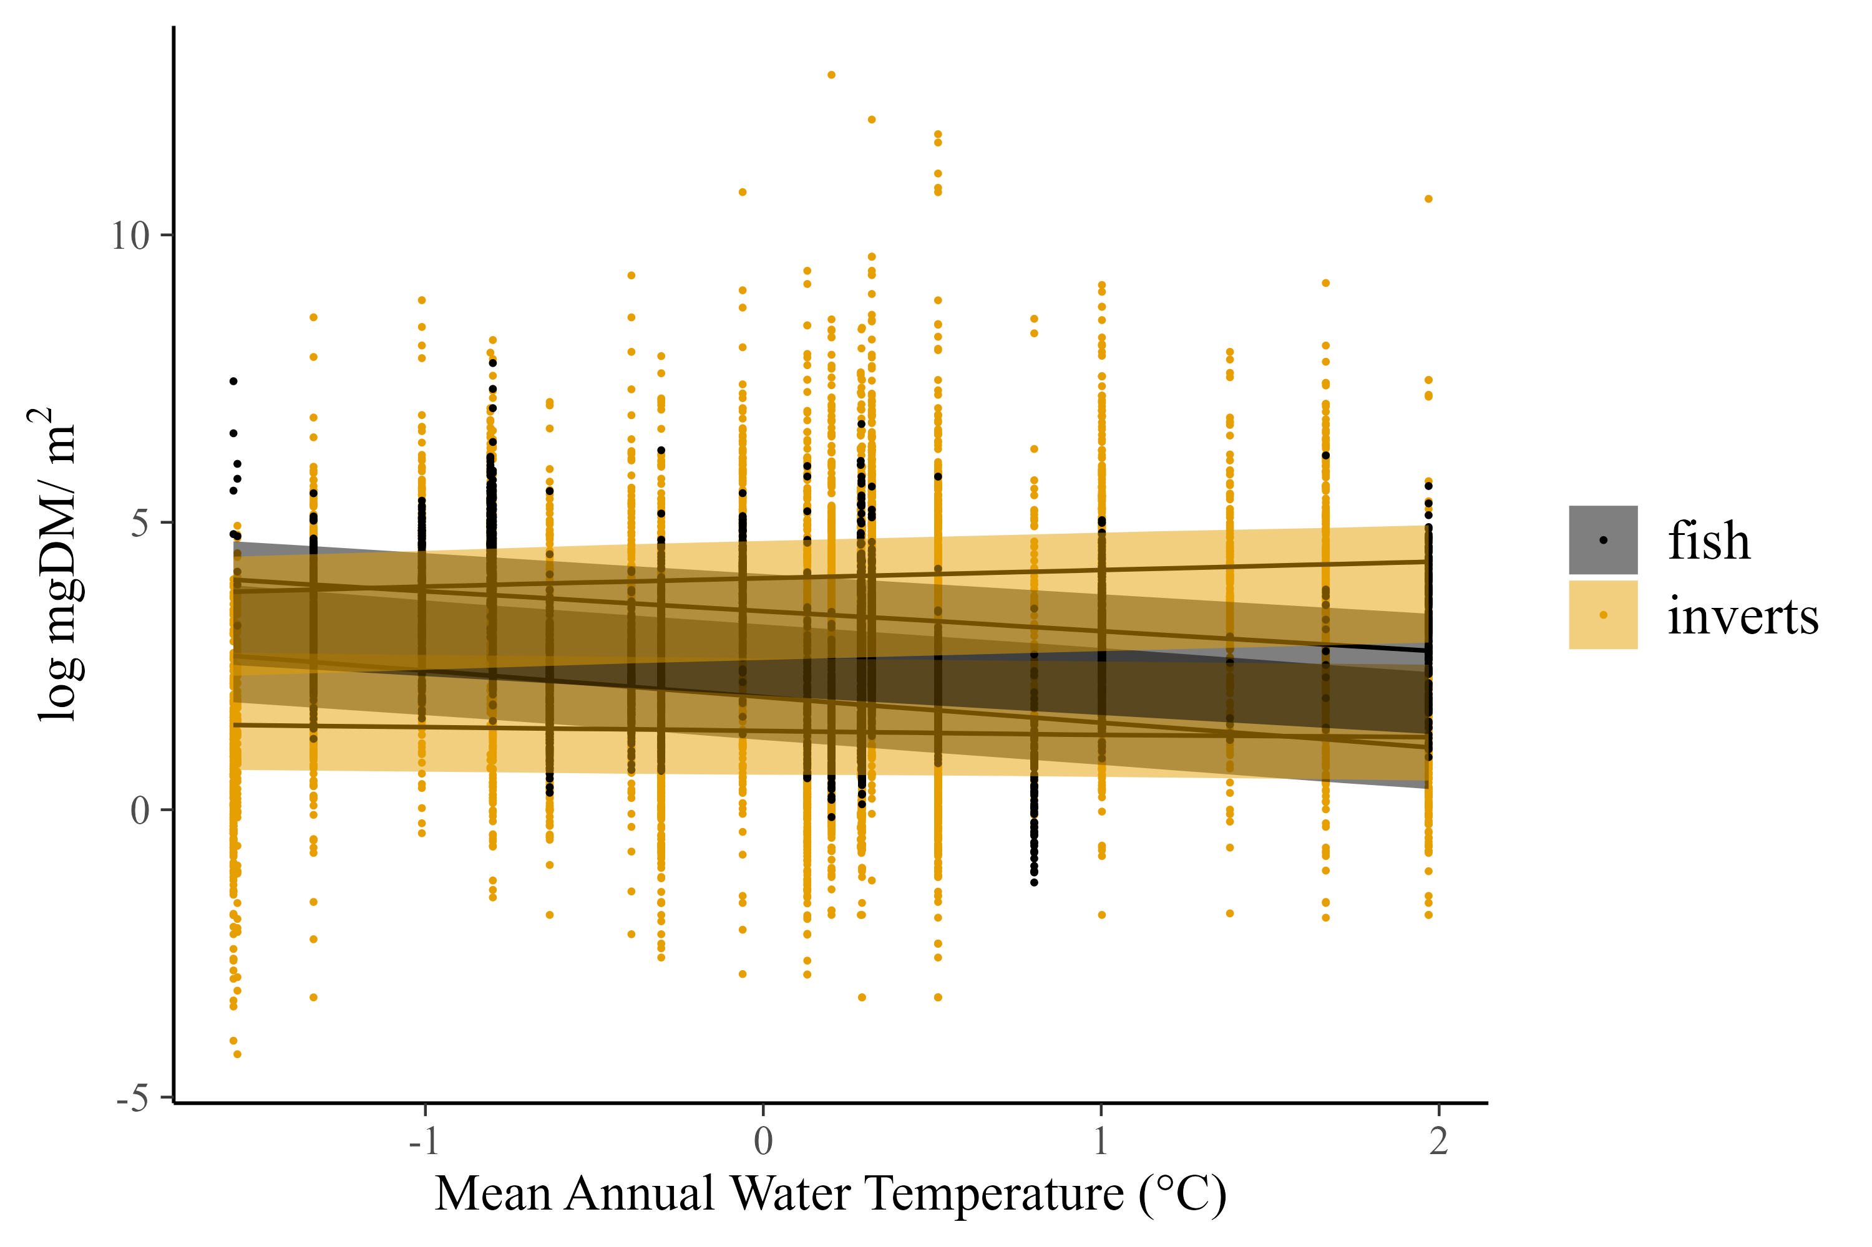
Quantile regression shows that all fish sizes get smaller with increasing temperature. In contrast, small invertebrates (0.2 quantile) don’t change, while large invertebrates (0.8 quantile) get larger. In other words, the increase in large inverts partially makes up for the decrease in fish size, keeping the ISD stable

Slide 7
Stream ISD is invariant to temperature and resource supply
Resource supply (organic matter + GPP)
Large scales of variation in temperature, OM, and GPP (and species composition)
These variables impact total mass and body sizes (also large ranges), but not the shape of the ISD.
Values of ISD are -1.2. That is shallower than predicted, but perhaps explained by the 2d benthic environment (similar to finding of Blanchard). Also perhaps driven by detrital fueled food webs versus more commonly studied pelagic.
Pomeranz et al. 2022 did it wrong. We corrected it by including the whole food web.

Slide 8
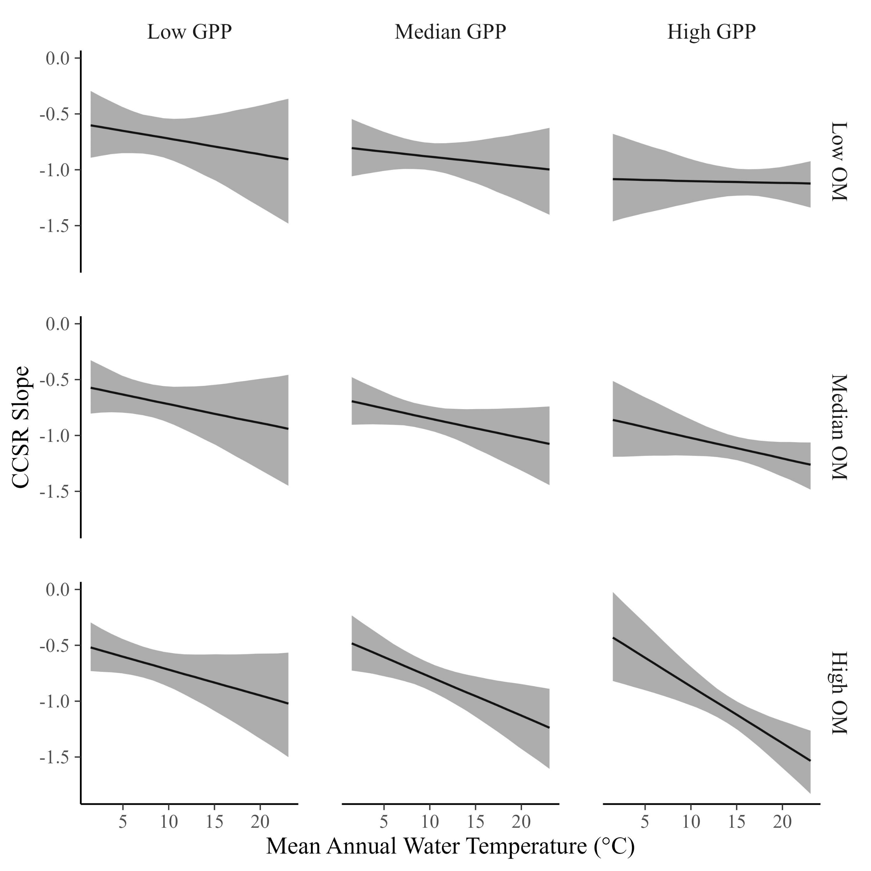
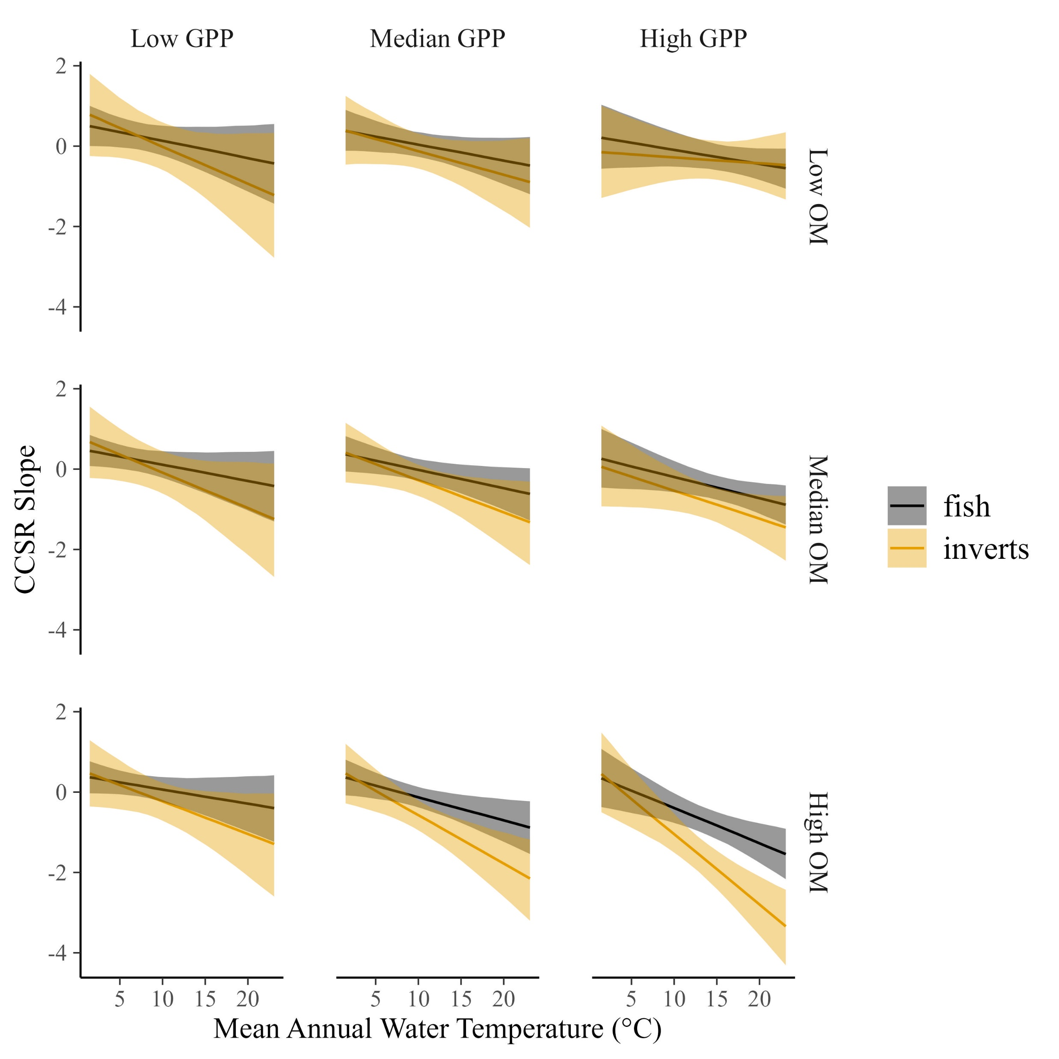
Perhaps for a different paper, but the cross-community size relationship also shows interesting patterns
The CCSR varies somewhat with temperature and resources, ranging from about -0.7 to -1…
…but that variation is minimal compared to the changes for fish or invertebrates separately.

Slide 9
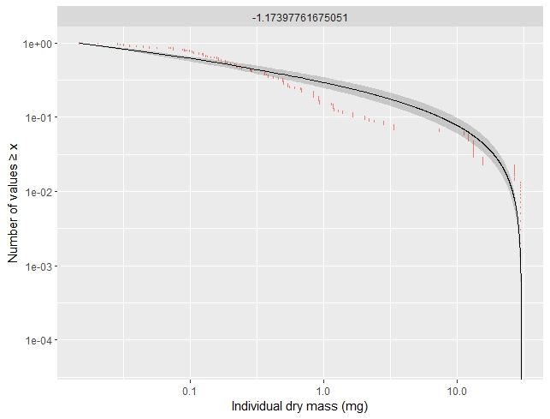
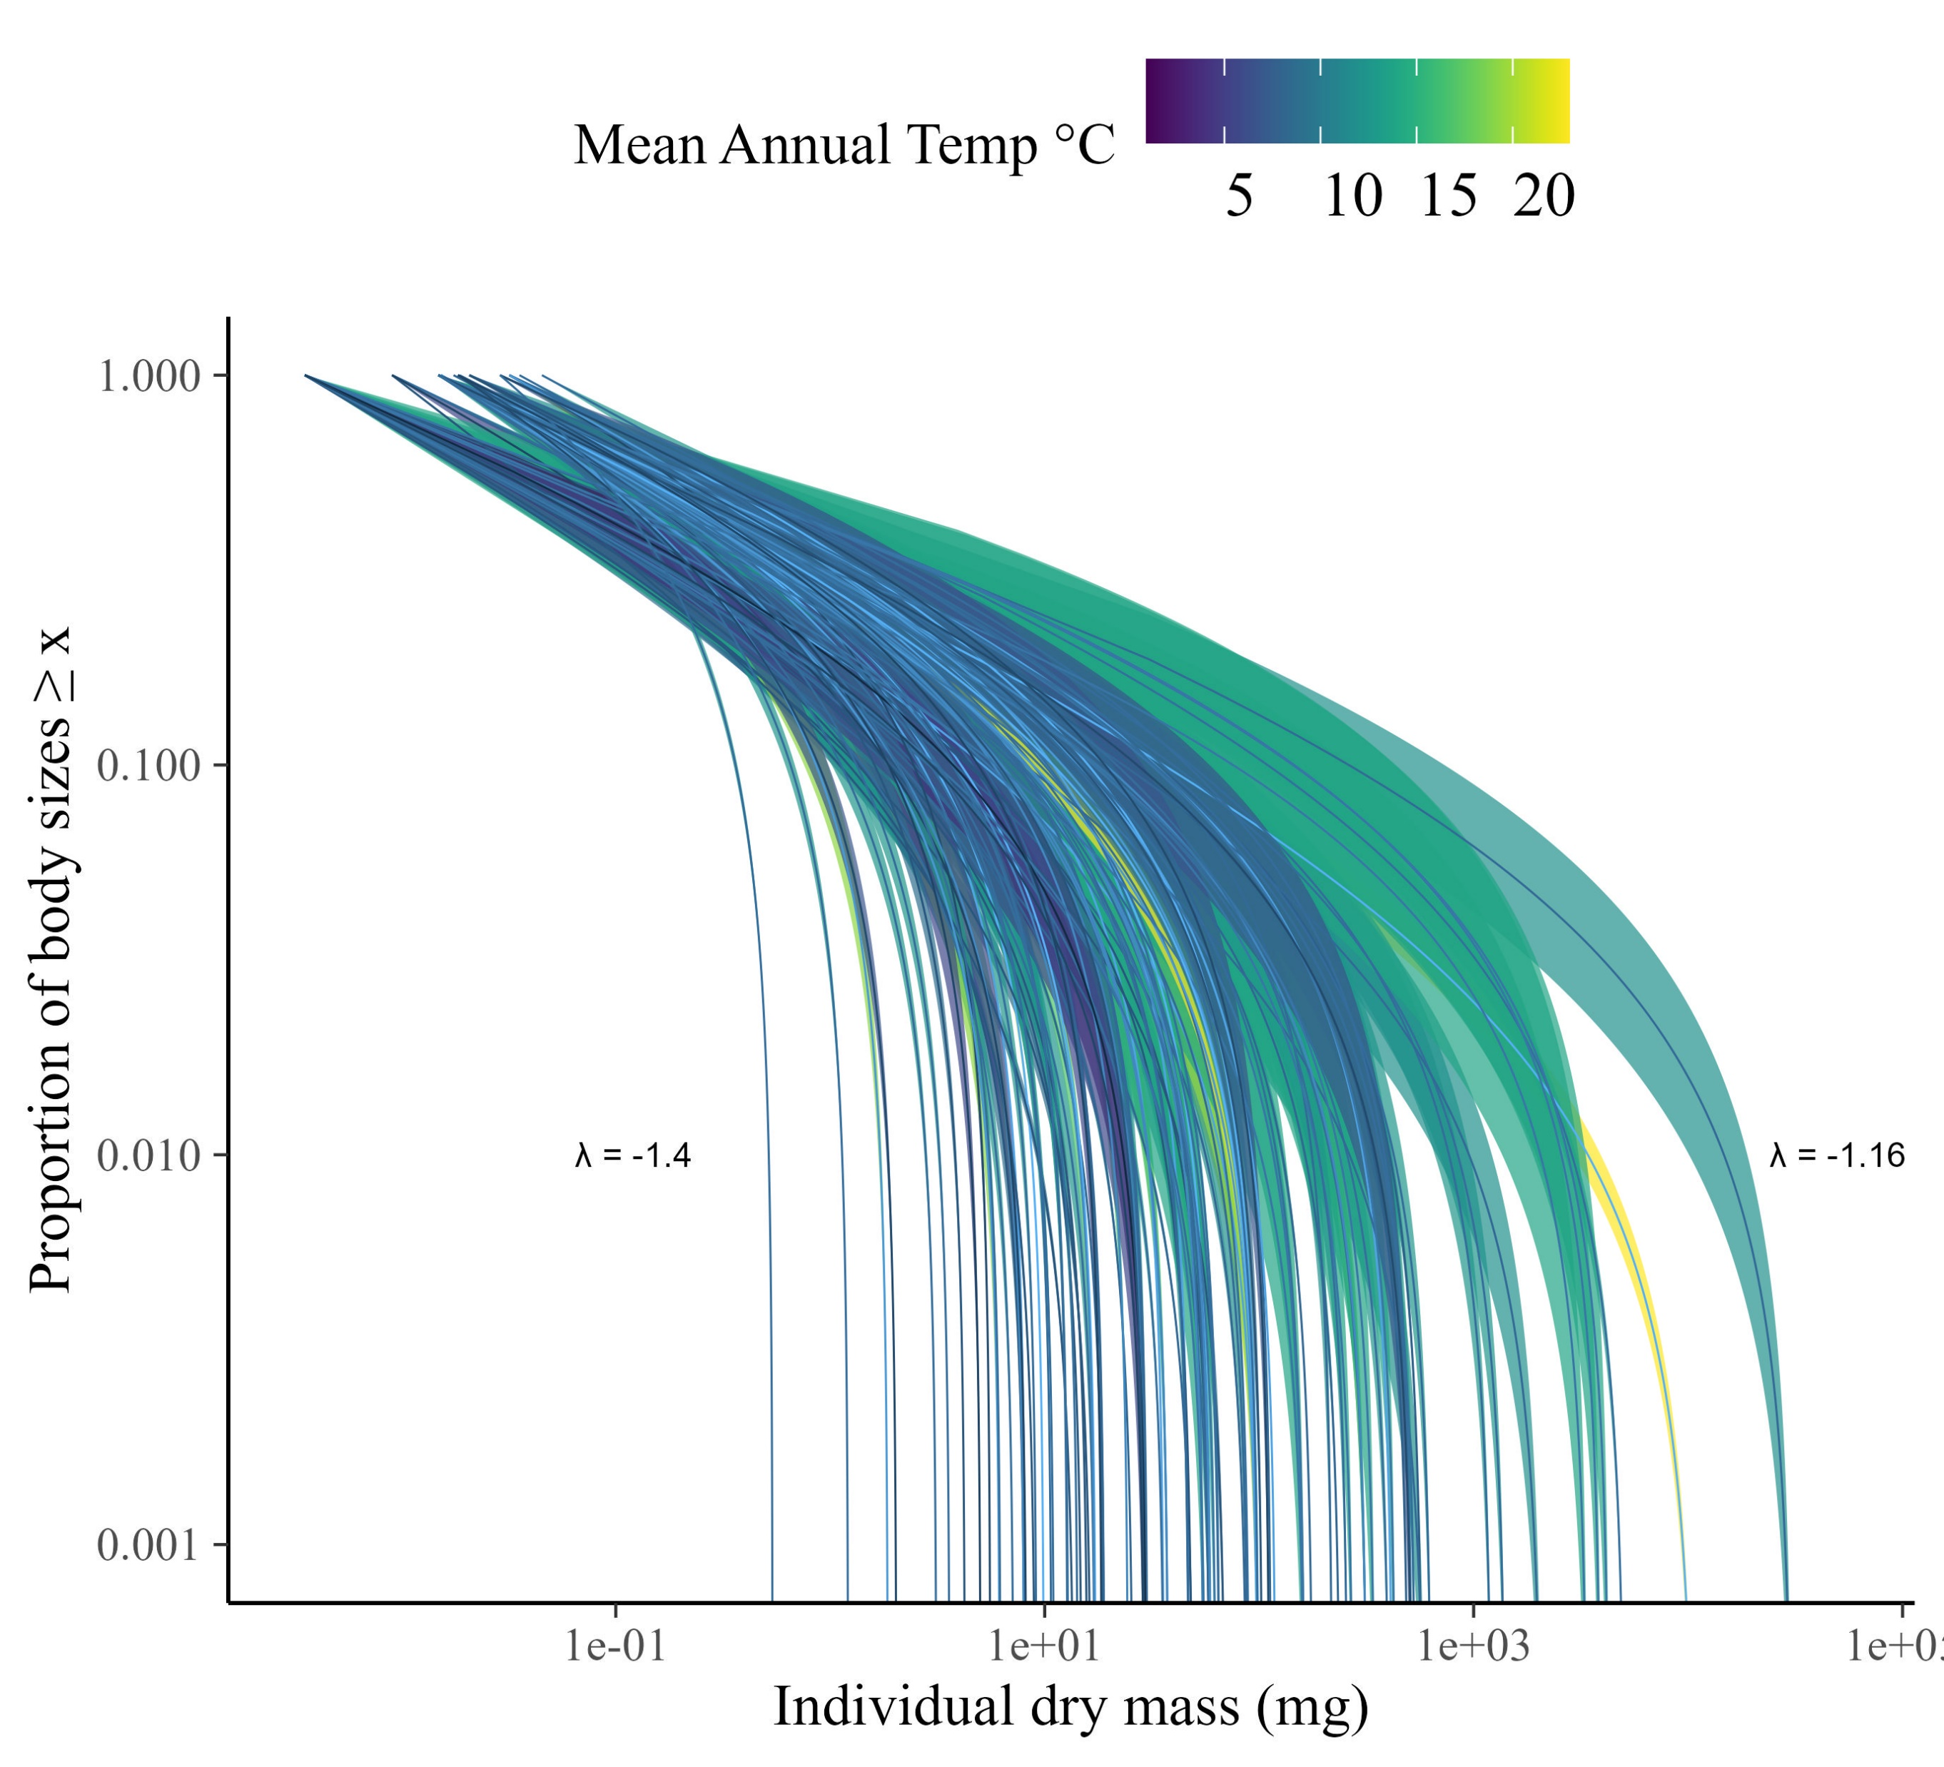
ISD’s vary among samples (posteriors shown).

Slide 10
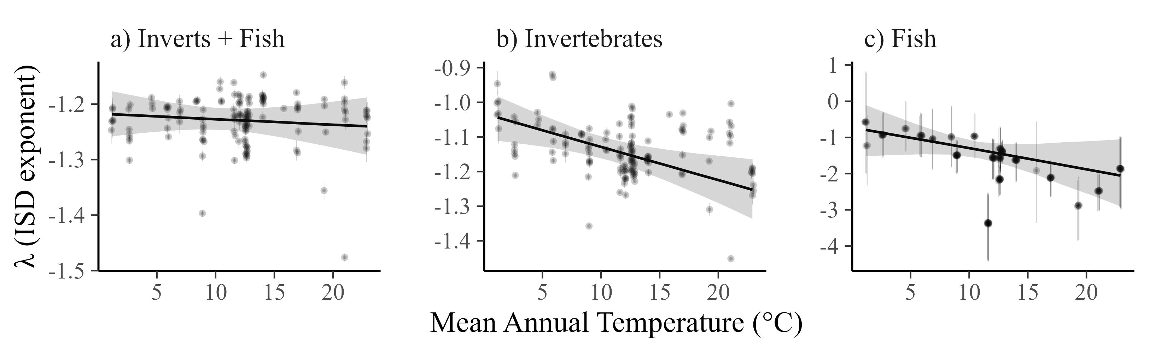
But ISD does not vary with temperature
*Note the change in y-axis scales across panels.

Slide 11
ISD consistency is independent of OM and GPP (i.e., no interactions)

Slide 12
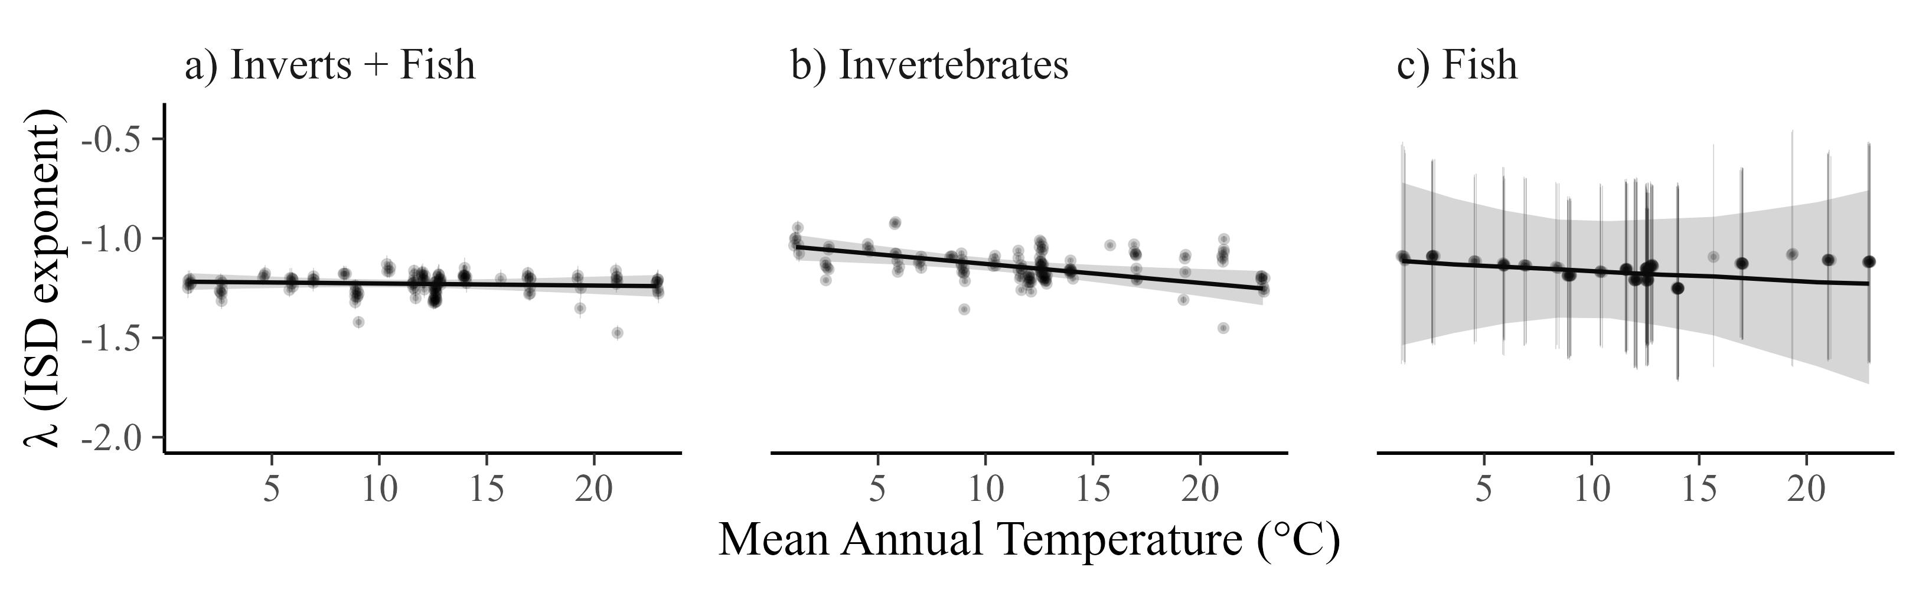
However, for individual taxa (inverts and fish), the ISD declines with temperature, particularly for fish.
*Note the change in y-axis scales across panels.

Slide 13
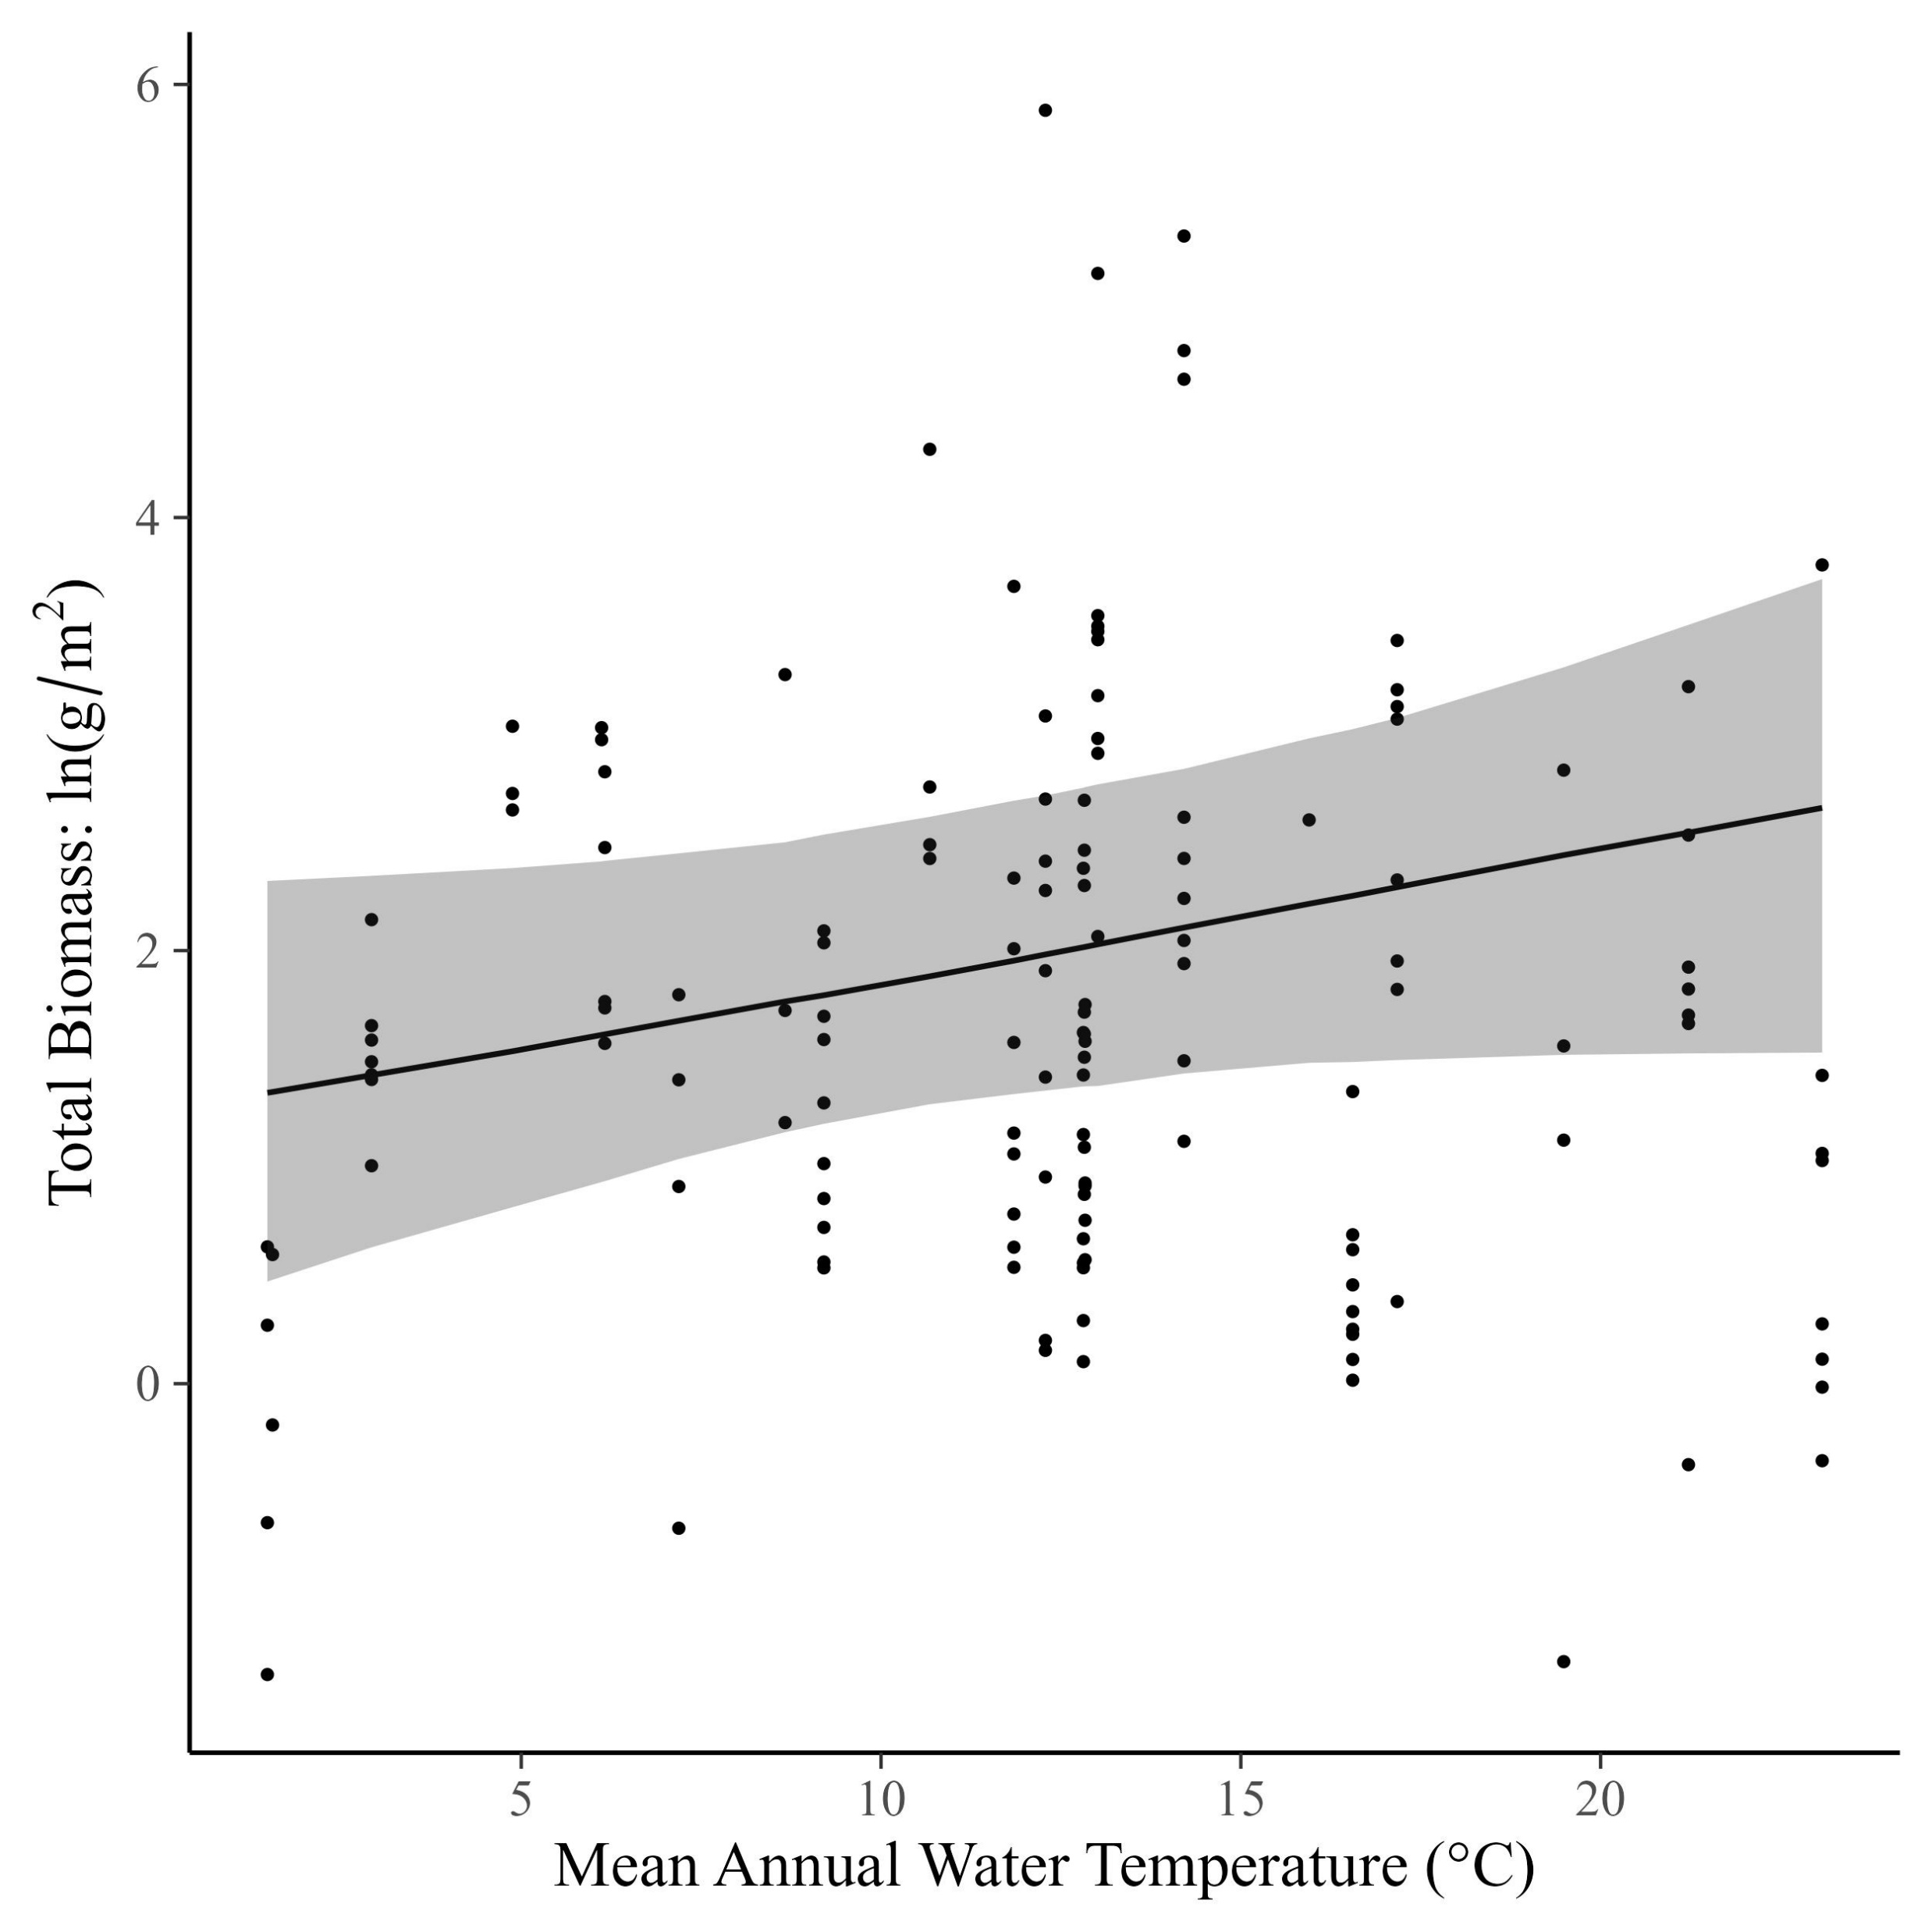
Total community mass weakly increases with temperature (0.04 [95% CI: -0.22, 0.3])

Slide 14
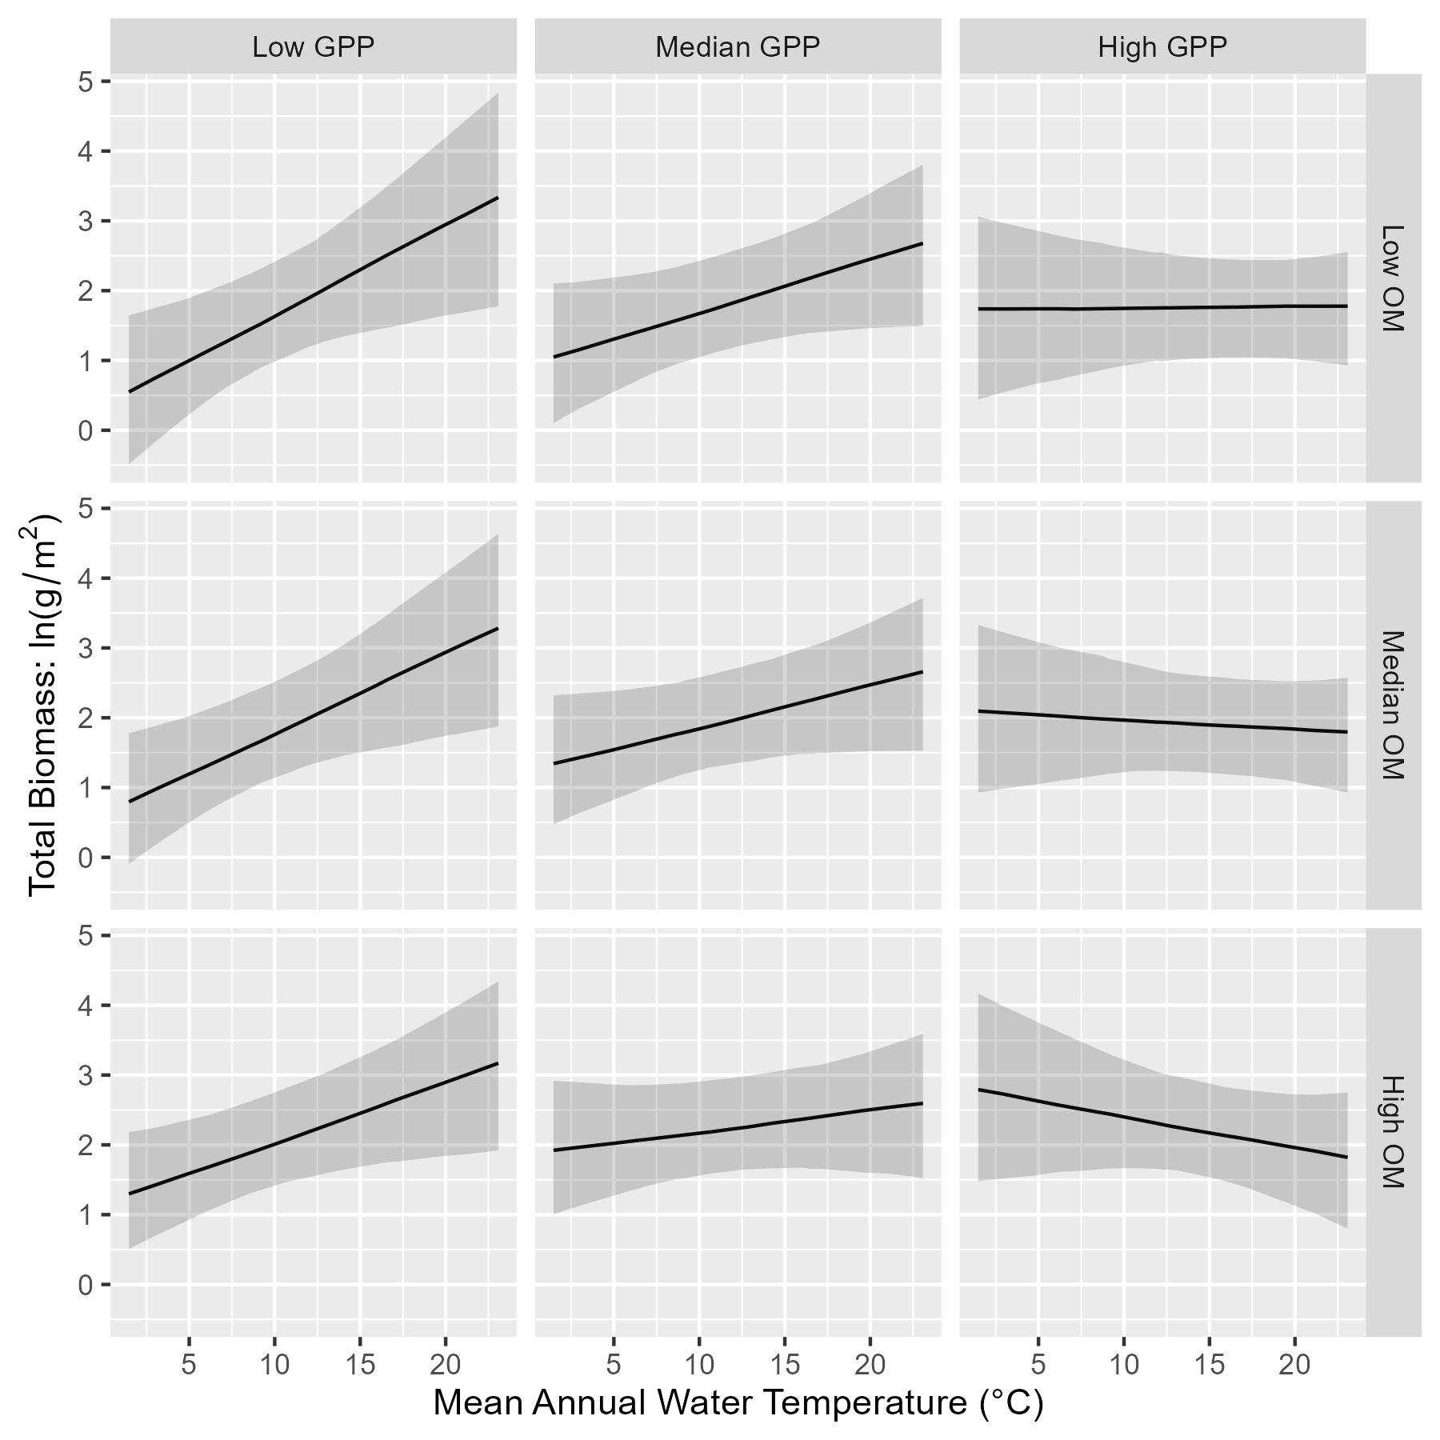
But…relationship of total biomass with temperature depends on resources. It is positive at low GPP and low OM, but becomes negative at high GPP and high OM.

Slide 15
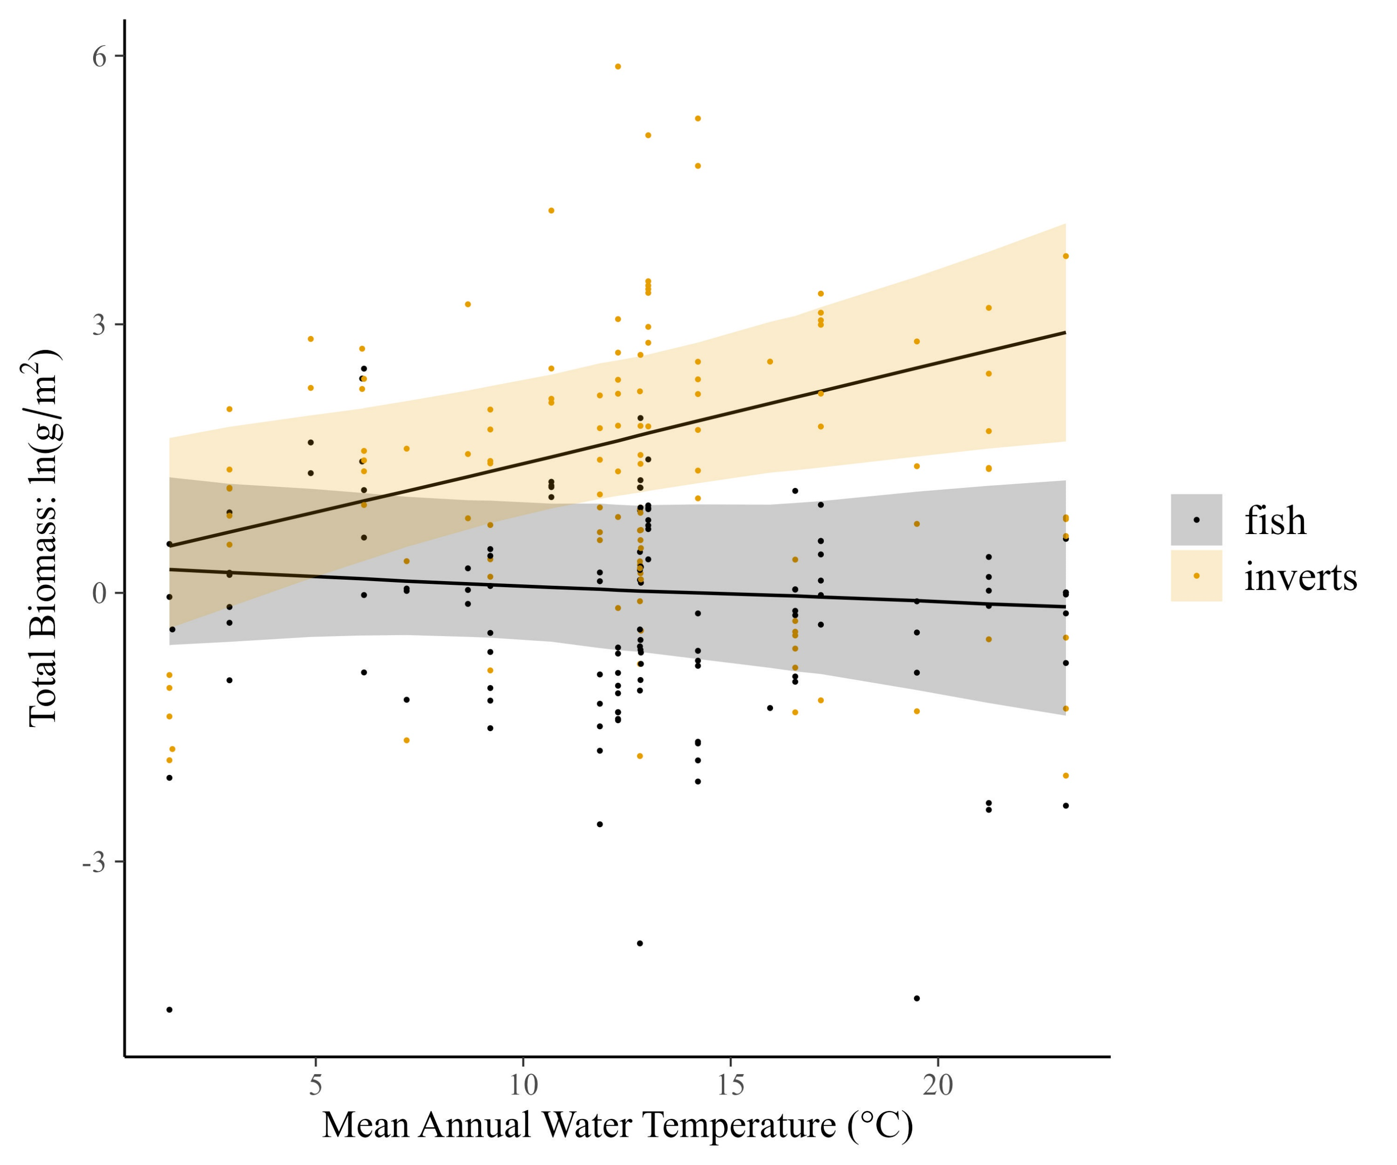
Temperature dependence of total biomass also differs for fish and inverts

Slide 16
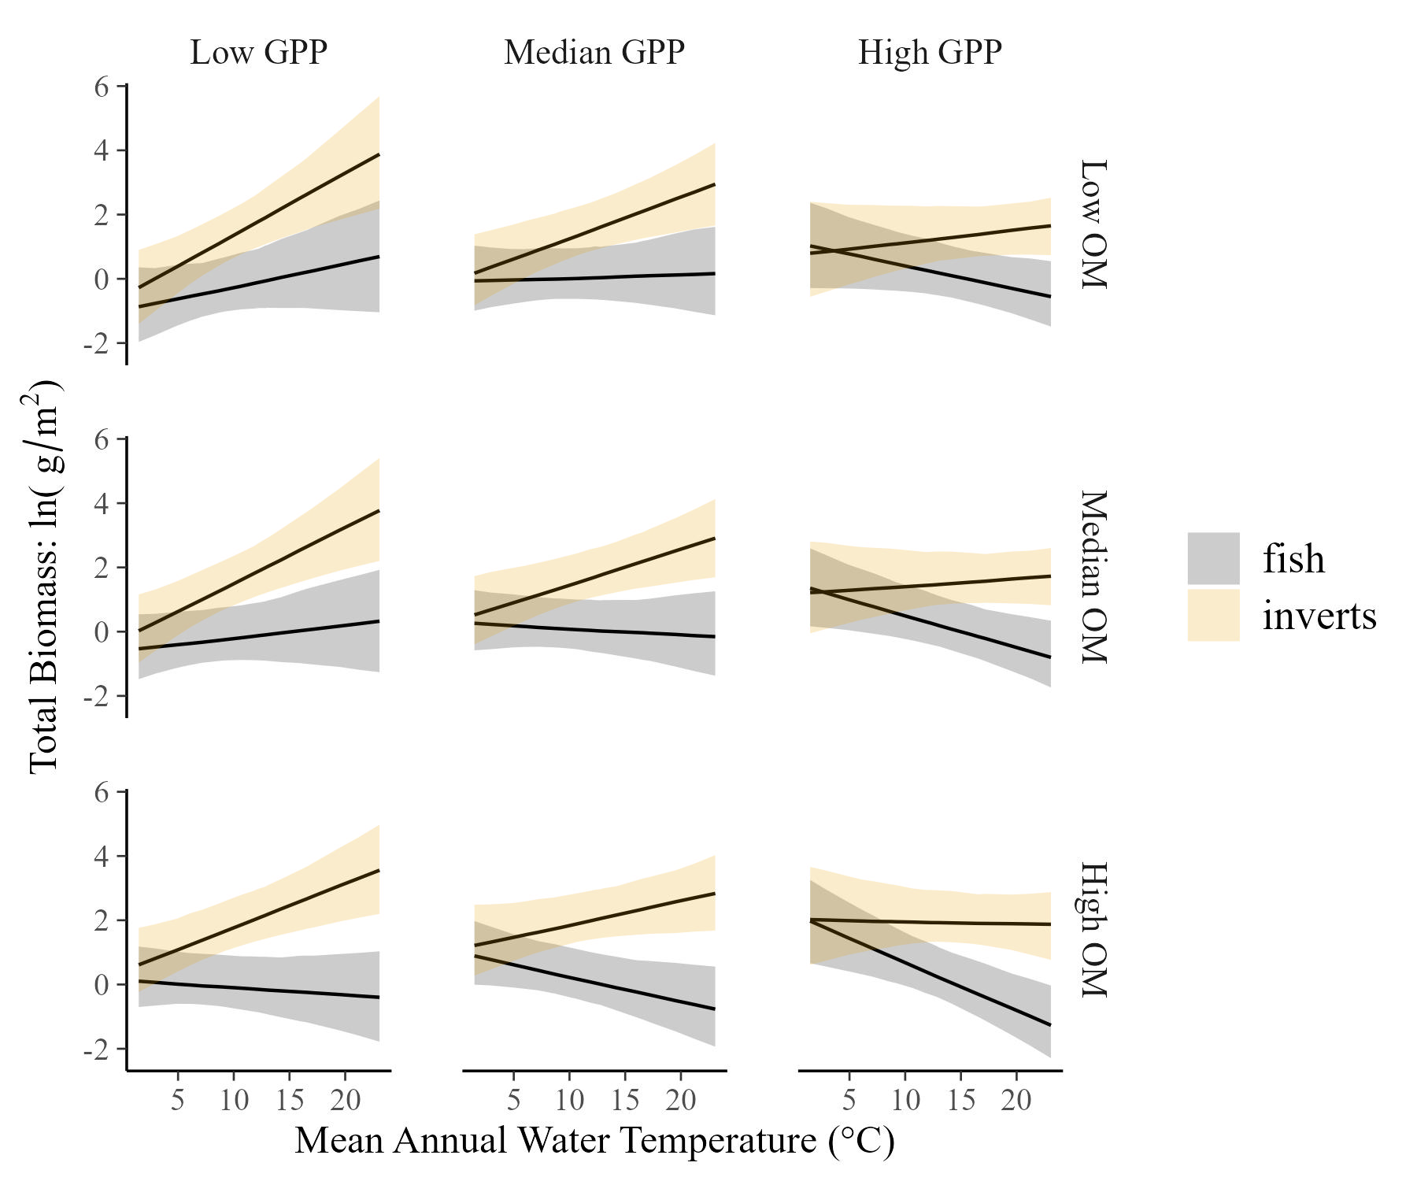
Temperature dependence of total biomass also differs for fish and inverts…with interactions of resource supply

Slide 17
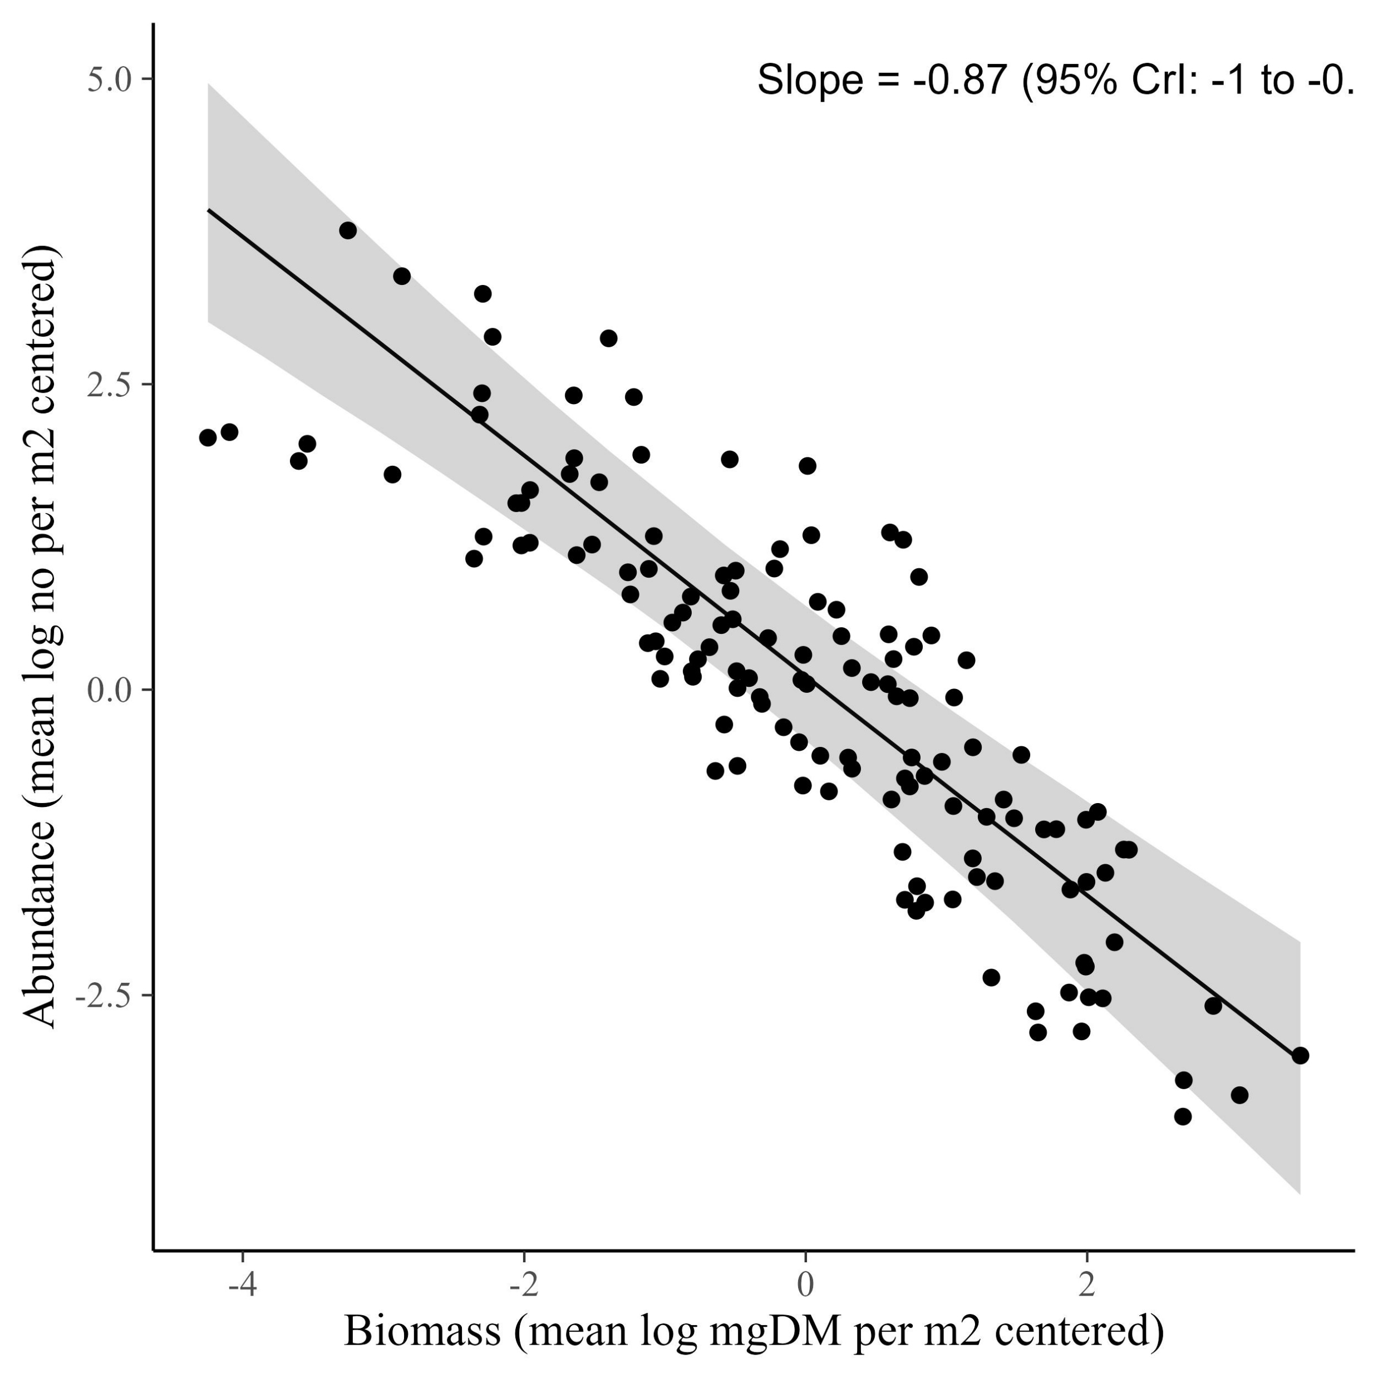
The CCSR is -0.87

Slide 18
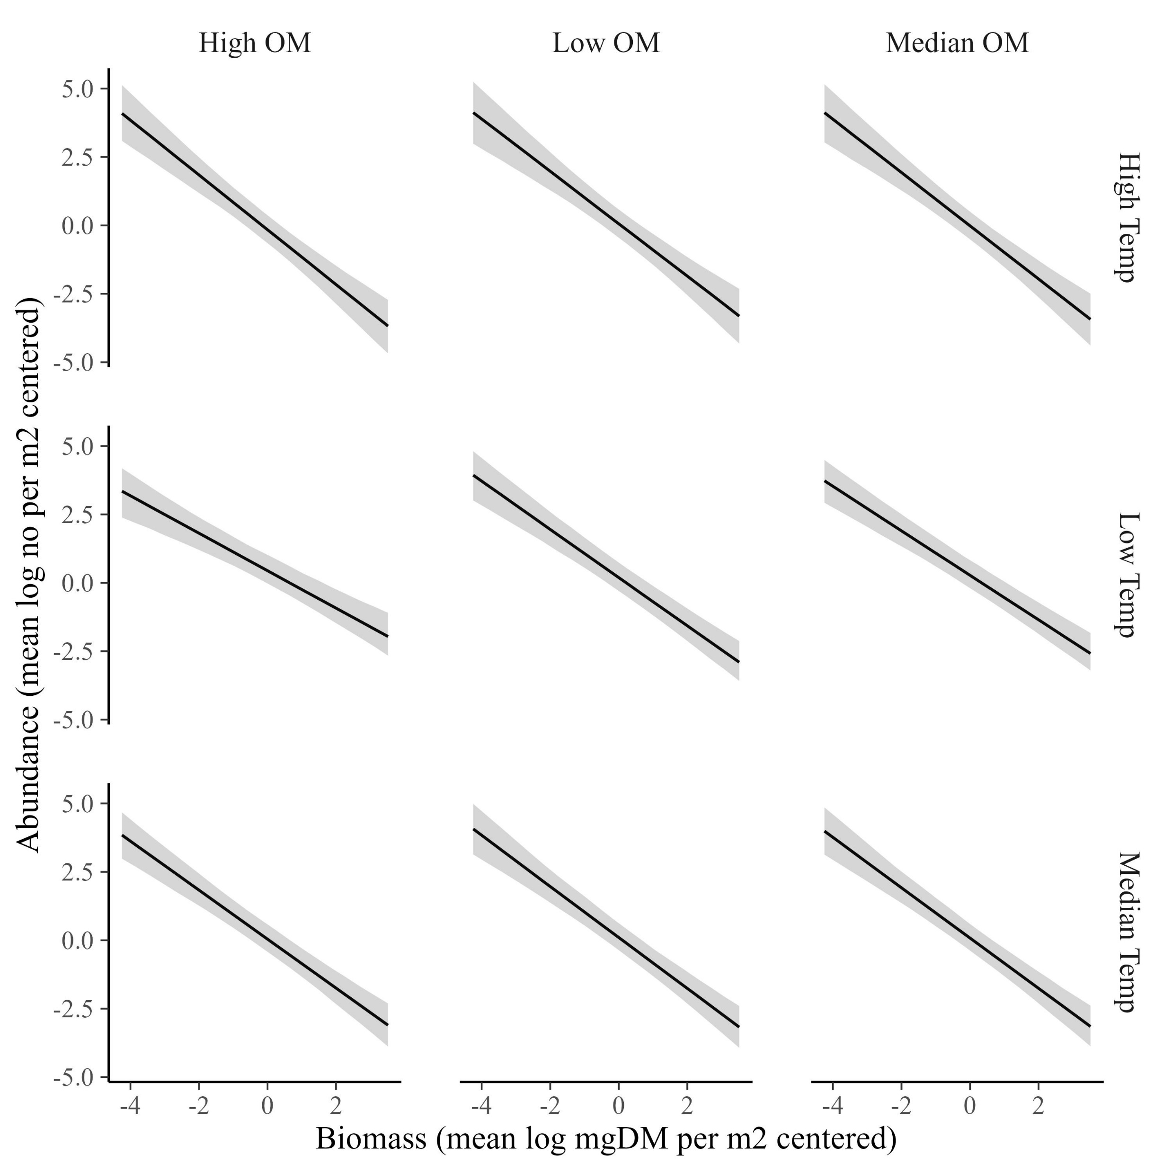
The CCSR for the whole community is invariant across temperature and resources (data shown with GPP at it’s median)

Slide 19
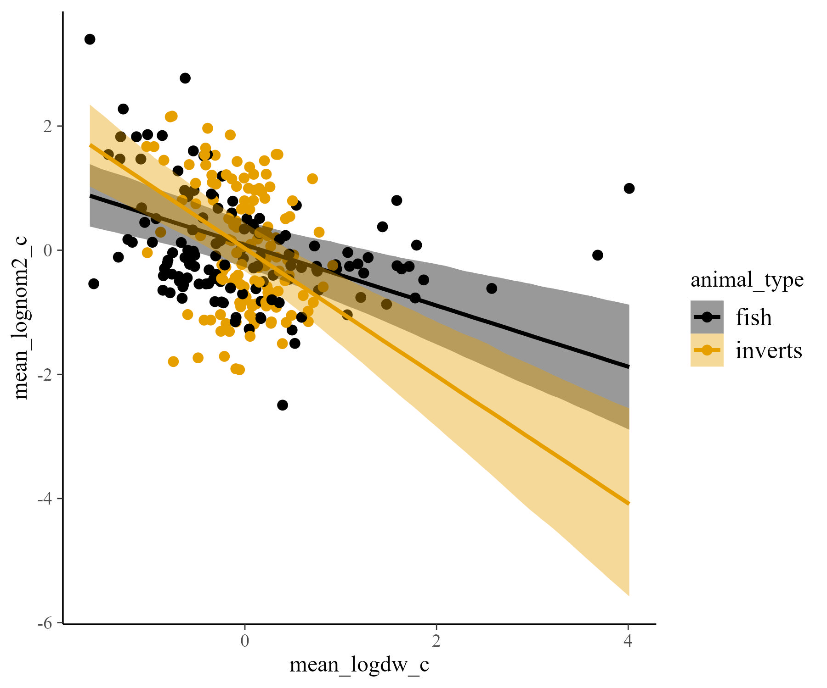
It varies by animal type, however (fish are -0.4, inverts are -0.9)

Slide 20
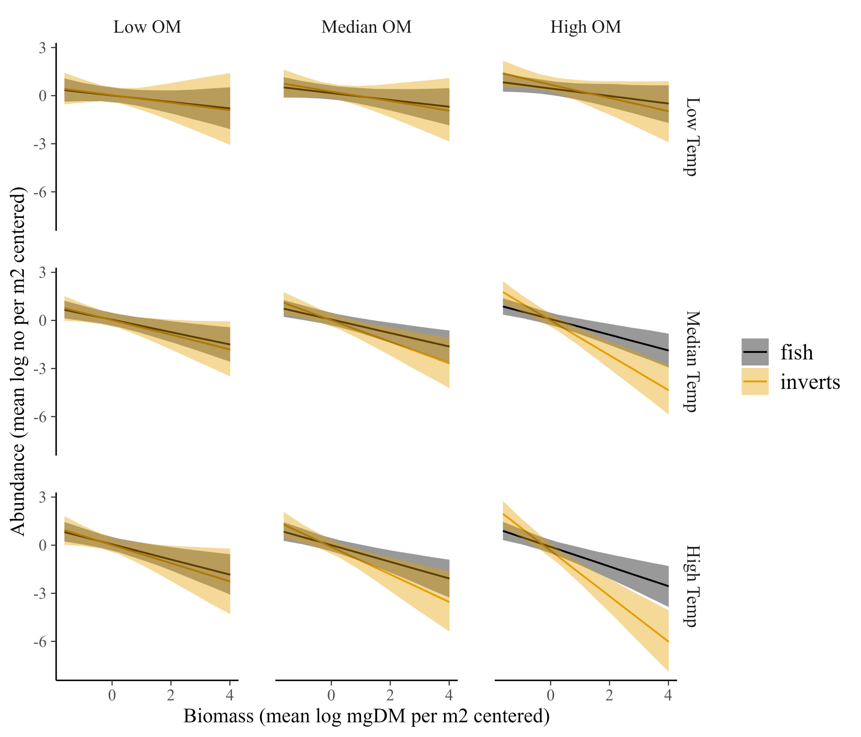
The CCSR becomes more negative at high temperature and high resource, especially for inverts (data shown with GPP at it’s median)

